Slide 1


Slide 2






ECONOMIC COMPARISON OF WIND POWER
AND
GAS-POWERED THERMAL POWER PLANTS IN EUROPE
PRESENTED BY
ANTHONY PENN NCHINDA
MD SAZZAD HOSSAIN KHAN
YE HTET KYAW
MD ASIFUR RAHMAN SAIKOT

Slide 3
1
Presentation Outline
Thesis Statement and our goal
Infrastructure of wind energy and gas-fired power plants
Breakdown of O&M costs
Comparison of cost per kWh in 20 years
Result and Conclusion
PRESENTED BY
ANTHONY PENN NCHINDA

Slide 4
2
Thesis Statement
Wind energy is cheaper than gas-fired thermal power plants.
PRESENTED BY
ANTHONY PENN NCHINDA

Slide 5
3
Our Goal
To prove the wind energy, despite its high initial costs, is seen to be cheaper in the long run, especially in areas where gas prices are high and unstable.
PRESENTED BY
ANTHONY PENN NCHINDA

Slide 6
4
Wind Energy Infrastructure
Wind farms consist primarily of turbines that convert kinetic energy of the wind into electrical power. Each turbine has three main components:
Rotor blades
Nacellee (houses the generator)
Tall tower
Turbines are connected to the grid through substations to transmit power.
Wind energy relies on natural, renewable resources and requires less complex infrastructure than thermal power plants.
[1,2]
PRESENTED BY
MD SAZZAD HOSSAIN KHAN

Slide 7
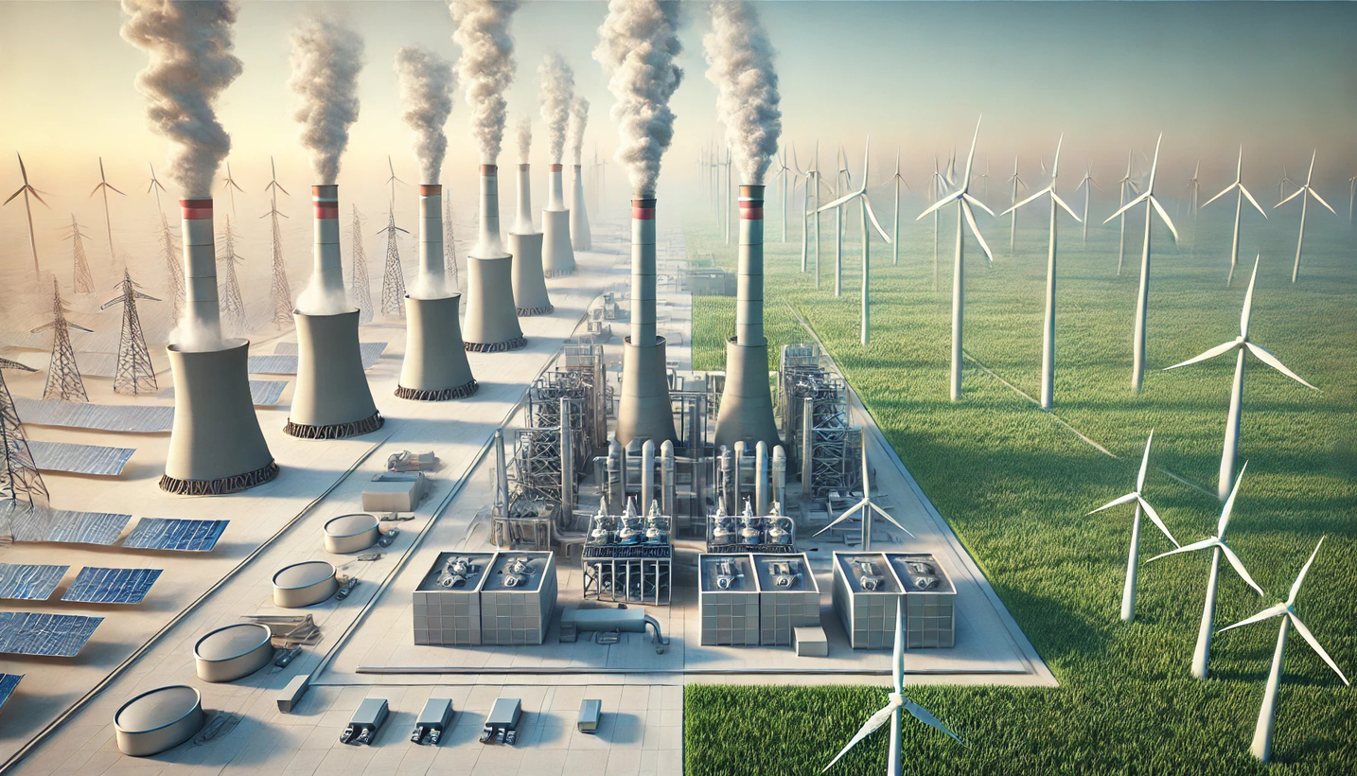
5
[8]
PRESENTED BY
MD SAZZAD HOSSAIN KHAN

Slide 8
6
Gas-Powered Thermal Power Plants
Gas plants generate electricity by burning natural gas to produce heat, which turns water into steam. The steam drives a turbine connected to a generator. Key components include:
Boilers
Cooling towers
Extensive fuel supply chains
Gas plants require continuous fuel input and emit carbon dioxide, contributing to climate change, with higher operational costs compared to wind energy.
[1,2]
PRESENTED BY
MD SAZZAD HOSSAIN KHAN

Slide 9
7
Preventive Maintenance
Routine Maintenance
Parts and Material Costs
Maintainenace Cost
Corrective Maintenance
Emergency Repairs
Labor Costs
Administrative Expenses
Miscellaneous Costs
[3]
PRESENTED BY
YE HTET KYAW

Slide 10
8
Regulatory Compliance
Fuel Cost
Insurance
Operational Cost
Logistics and Transportation
Grid connection and transmission
Labor Costs
Administrative Expenses
Miscellaneous Costs
[3]
PRESENTED BY
YE HTET KYAW

Slide 11
9
Calculating the Total Energy Production
We will use the following formula to calculate the total electricity produced in both types of power plants over a time period of 20 years.
Total Energy Production over 20 Years
Installed Capacity × 8760 hours/year
× Capacity Factor × 20
=
Installed Capacity (MW) | Capacity Factor (Gas TPP) | Capacity Factor (Wind PP)
2 | 0.50 | 0.25
Gas-Powered TPP | Wind Power Plant
8760 | 4380
Annual Energy Production (MWh)
TABLE-1: POWER PLANT SPECIFICS
TABLE-2: ANNUAL ENERGY PRODUCTION
[4,5,6,7]
PRESENTED BY
MD ASIFUR RAHMAN SAIKOT

Slide 12
10
Calculating Total Cost
We will use the following formula to calculate the total in both types of power plants over a time period of 20 years.
Annual Cost = Fuel cost + O&M cost
Total Cost over 20 Years = Capital Cost + Annual Cost × 20
Per kWh Price = (Total Cost over 20 Years) / (Total Energy Production over 20 Years)
[4,5,6,7]
PRESENTED BY
MD ASIFUR RAHMAN SAIKOT

Slide 13
11
Calculating Total Cost & price/kWh (Wind Power Plants)
Installed Capacity = 2MW
Capital Cost = 1.350.000€/MW (average)
Annual O&M cost = 394.200€
Annual Fuel Cost = 0€
TIme Period = 20 years
Total Cost = 2700000 + (394.200 + 0) * 20 = 10.584.000€
Price/kWh = Total Cost/Total energy production
= 10.584.000/(4380*1000*20) = 0,12€/kWh
[4,5,6,7]
PRESENTED BY
MD ASIFUR RAHMAN SAIKOT

Slide 14
12
Calculating Total Cost & price/kWh
(Gas-Powered TPP)
Installed Capacity = 2MW
Capital Cost = 1.350.000€/MW (average)
Annual O&M cost = 45.000€
Annual Fuel Cost = 613.200€
TIme Period = 20 years
Total Cost = 2700000 + (45000 + 613200) * 20 = 15.862.200€
Price/kWh = Total Cost/Total energy production
= 15.862.200/(8760 * 1000 * 20) = 0,09€/kWh
[4,5,6,7]
PRESENTED BY
MD ASIFUR RAHMAN SAIKOT

Slide 15
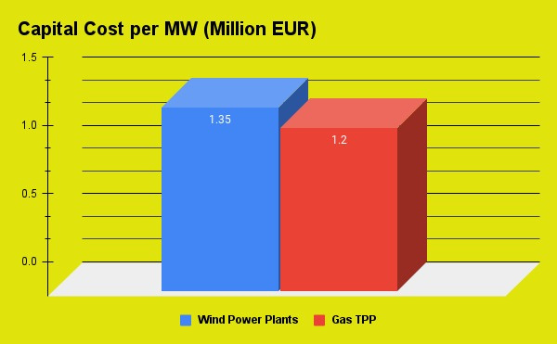
13
Graphical Illustration
Installed Capacity = 2MW
Capital Cost = 1.350.000€/MW (average)
Annual O&M cost = 45.000€
Annual Fuel Cost = 613.200€
TIme Period = 20 years
Total Cost = 2700000 + (45000 + 613200) * 20 = 15.862.200€
Price/kWh = Total Cost/Total energy production
= 15.862.200/(8760 * 1000 * 20) = 0,09€/kWh
[4,5,6,7]
PRESENTED BY
MD ASIFUR RAHMAN SAIKOT

Slide 16
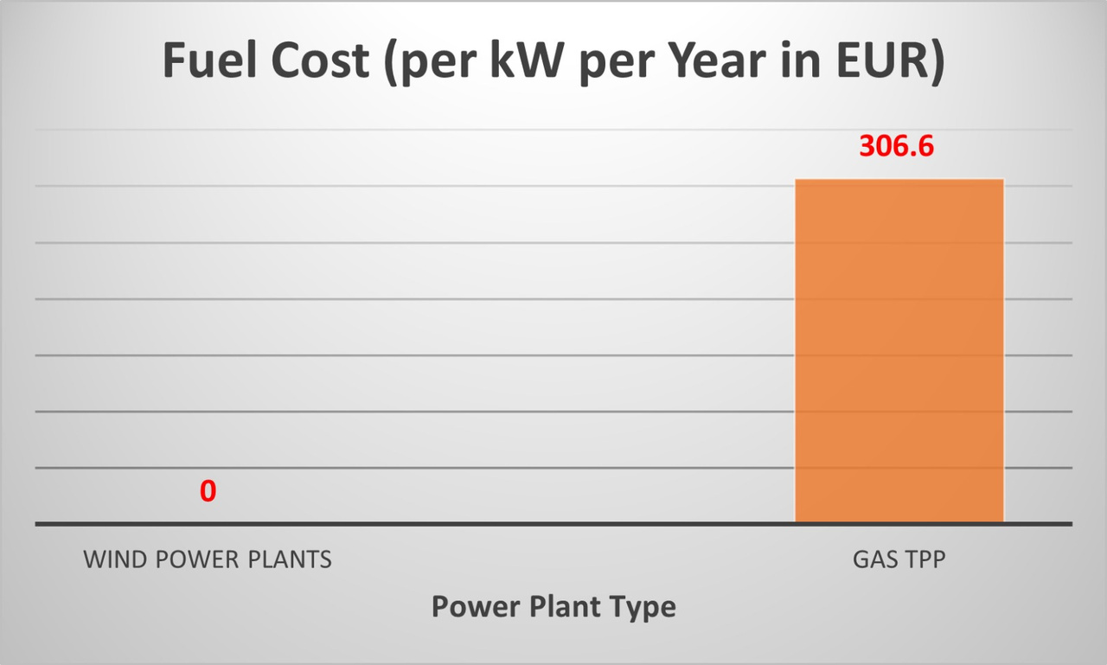
14
Graphical Illustration
[4,5,6,7]
PRESENTED BY
MD ASIFUR RAHMAN SAIKOT

Slide 17
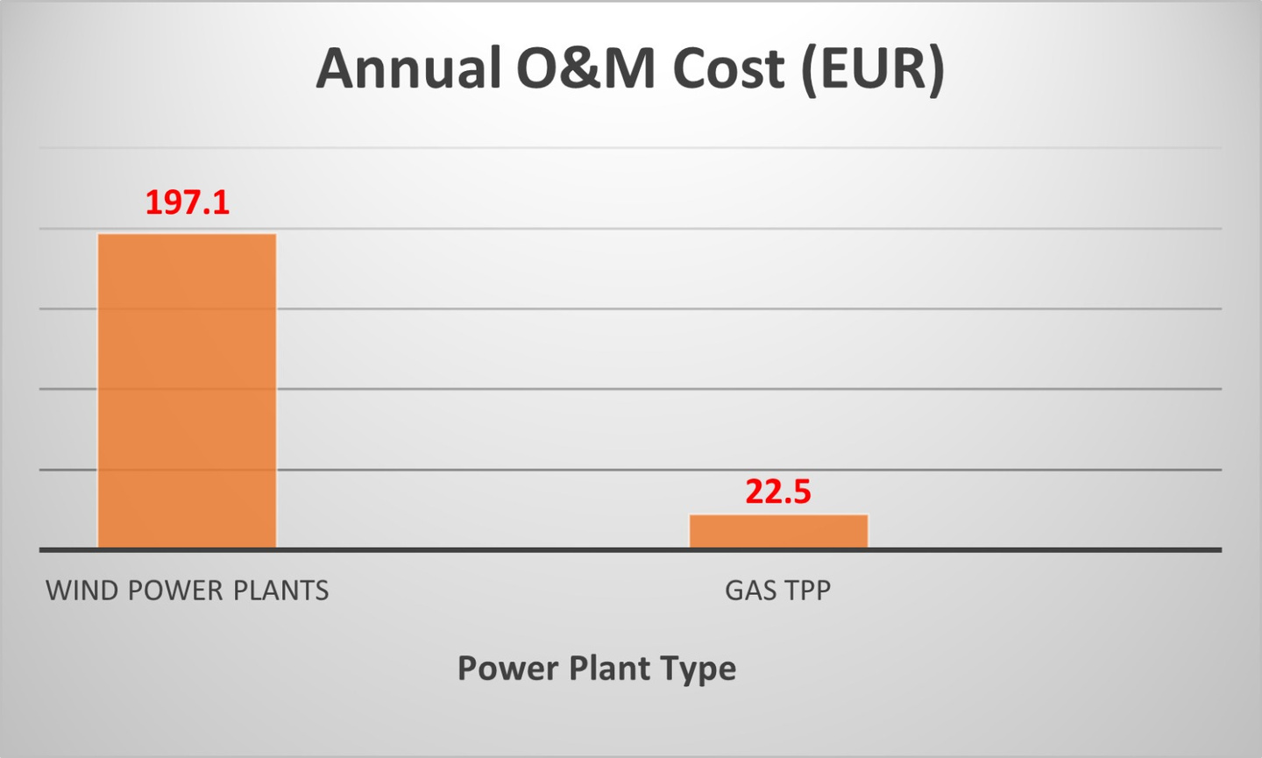
15
Graphical Illustration
[4,5,6,7]
PRESENTED BY
MD ASIFUR RAHMAN SAIKOT

Slide 18
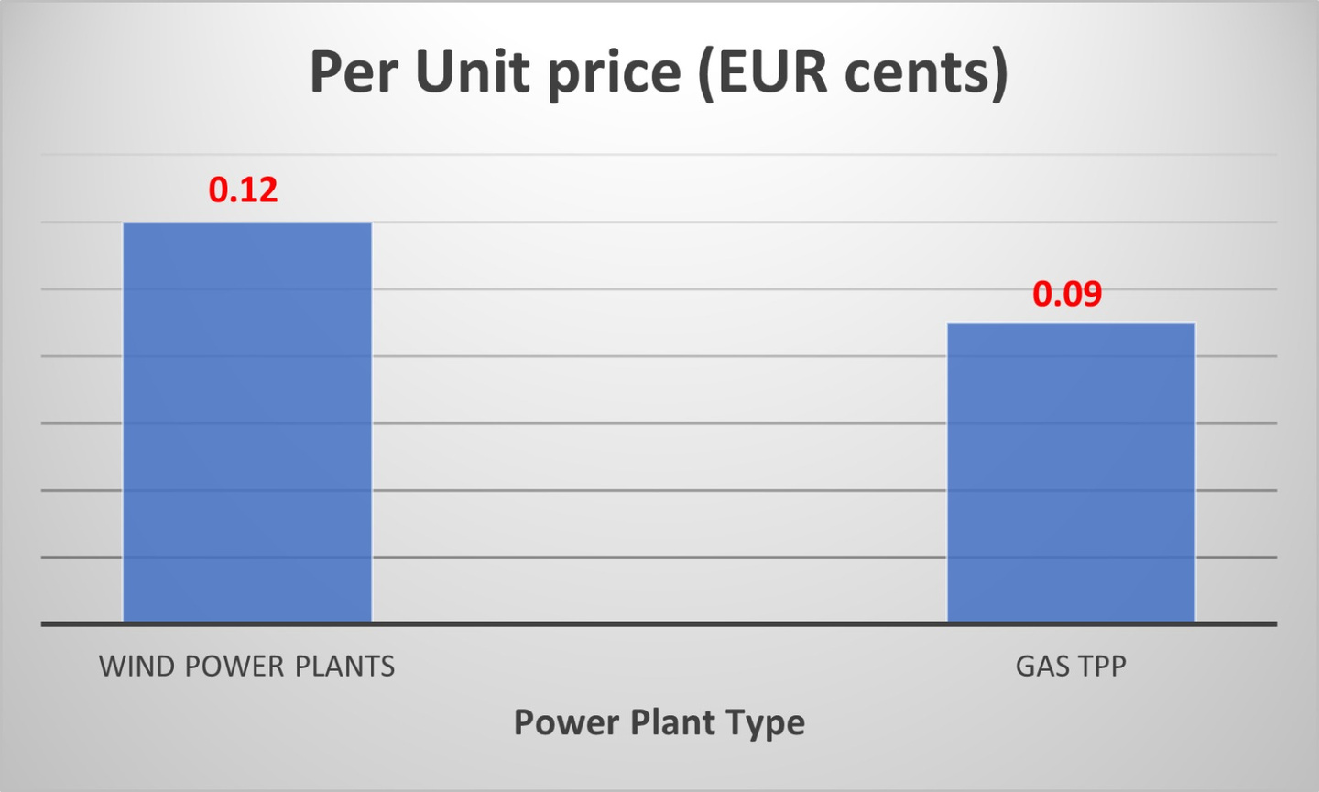
16
Graphical Illustration
[4,5,6,7]
PRESENTED BY
MD ASIFUR RAHMAN SAIKOT

Slide 19

17
Conclusion
Our thesis statement claims that wind power is cheaper than gas turbines.
However, the 2020 data suggests otherwise.
This data predates the Russian Special Military Operation in Ukraine when Russia was the EU's primary gas supplier.
Since 2022, the geopolitical shift has increased gas prices and electricity costs.
Although we lack recent data, gas turbine costs most likely match or exceed wind power costs.

Slide 20

18
Bibliography:
[1]M. A. Mueller, H. Polinder, and D. E. Macpherson, "Experimental tests of an air-cored PM tubular generator for direct drive wave energy converters," IET Renewable Power Generation, vol. 2, no. 1, pp. 1–10, Jan. 2008. [Online]. Available: https://digital-library.theiet.org/content/journals/10.1049/iet-rpg:20070001. [Accessed: Jan. 2, 2025].
[2]H. E. Payne, "Repurposing Fossil Infrastructure," Journal of Climate and Energy Law, vol. 15, no. 3, pp. 45–78, 2023. [Online]. Available: https://digital.sandiego.edu/jcel/vol15/iss0/3/. [Accessed: Jan. 2, 2025].
[3]A. M. Costa, J. A. Orosa, D. Vergara, and P. Fernández-Arias, "New Tendencies in Wind Energy Operation and Maintenance," Applied Sciences, vol. 11, no. 1386, pp. 1-26, 2021.
[4]International Renewable Energy Agency (IRENA), "Renewable Energy Cost Analysis: Wind Power," 2020. [Online]. Available: https://www.irena.org/-/media/Files/IRENA/Agency/Publication/2020/RE_Technologies_Cost_Analysis-WIND_POWER.pdf. [Accessed: Jan. 2, 2025].
[5]European Commission, "Final Report Cost of Energy (LCOE)," 2020. [Online]. Available: https://energy.ec.europa.eu/system/files/2020-10/final_report_levelised_costs_0.pdf. [Accessed: Jan. 2, 2025].
[6]Fraunhofer Institute for Solar Energy Systems ISE, "Study: Levelized Cost of Electricity Renewable Energy Technologies," 2024. [Online]. Available: https://www.ise.fraunhofer.de/content/dam/ise/en/documents/publications/studies/EN2024_ISE_Study_Levelized_Cost_of_Electricity_Renewable_Energy_Technologies.pdf. [Accessed: Jan. 2, 2025].
[7]International Energy Agency (IEA), "Projected Costs of Generating Electricity 2020," 2020. [Online]. Available: https://www.iea.org/reports/projected-costs-of-generating-electricity-2020. [Accessed: Jan. 2, 2025].
[8]OpenAI, "Conceptual illustration: Natural gas and wind power plants," DALL-E, Jan. 2025. [Online]. Available: ChatGPT interface.

Slide 21

19
Thank you very much for your attentions!
PRESENTED BY
ANTHONY PENN NCHINDA
MD SAZZAD HOSSAIN KHAN
YE HTET KYAW
MD ASIFUR RAHMAN SAIKOT

